Slide 1

Small wastewater treatment plants in Austria
Guenter Langergraber
IWA Fellow
Head of the Department of Water, Atmosphere and Environment
SWARM Workshop on innovative practices in the EU water sector: barriers and opportunities
9 May 2019, Vienna

Slide 2
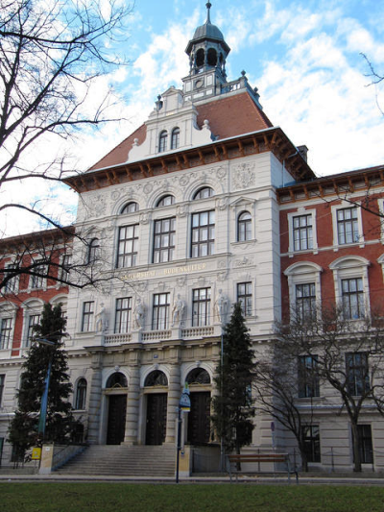
BOKU
University of Natural Resources and Life Sciences, Vienna
Universität für Bodenkultur Wien
Facts and figures
Founded 1872
Students: ca.12’500
Scientific staff: ca.1’800
Other staff: ca.500
Teaching, research and administrative facilities are located throughout Vienna at 20 different sites. Most of them are in the green districts – the 18th and 19th district – and are readily accessible by public transportation.
BOKU main building: A-1180 Vienna, Gregor Mendel-Strasse 33

Slide 3
BOKU bachelor programs
Agricultural Sciences
Environment and Bio-Resources Management
Civil Engineering and Water Management (Kulturtechnik und Wasserwirtschaft)
Food Science and Biotechnology
Forestry
Landscape Architecture and Landscape Planning
Equine Sciences
Viticulture, Enology and Wine Economics
Wood and Fibre Technology

Slide 4
BOKU master programs
Agricultural and Food Economy
Agricultural Biology
Alpine Natural Dangers / Watershed Regulation
Animal Breeding and Genetics - Double degree programme European Master (en)
Applied Limnology - Aquatic ecosystem management (en)
Applied Plant Sciences
Biotechnology
Civil Engineering and Water Management (Kulturtechnik und Wasserwirtschaft)
Environment and Bio-Resources Management
Environmental Sciences - Soil, Water, Biodiversity (ENVEURO) - (en)
European Forestry - Double degree programme (en)
Food Science and Technology
Forest Sciences
Horticultural Sciences (en)
Landscape Architecture and Landscape Planning
Livestock Sciences
Material and Energetic Exploitation of Renewable Raw Materials (NAWARO) (en)
Mountain Forestry (en)
Natural Resources Management and Ecological Engineering (en)
Organic Agricultural Systems and Agroecology (AgrEco-Organic) (en)
Organic Farming
Phytomedicine
Safety in the Food
Water Management and Environmental Engineering (en)
Wildlife Ecology and Wildlife Management
Wood Technology and Management

Slide 5
BOKU doctoral programs
Doctoral studies of Natural Resources and Life Sciences
Doctoral programme in Social and Economic Sciences
PhD Programmes
  Biomolecular Technology of Proteins (BioToP)
  International Graduate School in Nanobiotechnology (IGS-NanoBio)
BOKU Doctoral Programmes
  Advanced Biorefineries, Chemistry & Materials (ABC&M)
  Bioprocess Engineering (BioproEng)
  Human River Systems in the 21st century (HR21)
  Transitions to Sustainability (T2S)

Slide 6
Departments
Department of Material Sciences and Process Engineering
Department of Biotechnology
Department of Water, Atmosphere and Environment
Department of Nanobiotechnology
Department of Chemistry
Department of Integrative Biology and Biodiversity Research
Department of Food Sciences and Technology
Department of Spatial-, Landscape-, and Infrastructure-Sciences
Department of Economics and Social Sciences
Department of Sustainable Agricultural Systems
Department of Structural Engineering and Natural Hazards
Department of Forest- and Soil Sciences
Department of Applied Plant Sciences and Plant Biotechnology
Department of Agrobiotechnology (IFA Tulln)
Department of Applied Genetics and Cell Biology

Slide 7
Other scientific units and initiatives
Centre for Development Research (CDR)
Center for Global Change and Sustainability
Center for Agricultural Sciences
Vienna Institute of BioTechnology
Bio- Resources & Technologies Tulln
BOKU Network for Bioconversion of Renewables
BOKU Energy-Cluster
WasserCluster Lunz - Biologische Station GmbH
BIOENERGY 2020+ GmbH
…

Slide 8
Department of
Water, Atmosphere and Environment
Head:
PD DI Dr Guenter LANGERGRABER
www.wau.boku.ac.at
Institute of Sanitary Engineering and Water Pollution Control
Institute of Hydrobiology and Aquatic Ecosystem Management
Institute of Waste Management
Institute of Meteorology and Climatology
Institute of Soil Physics and Rural Water Management
Institute of Hydrology and Water Management
Institute of Safety and Risk Sciences
Institute of Hydraulic Engineering and River Research
Workshops of the Hydraulic Engineering Institutes
Notes:
Vorstellung:
Wgt
war einige jahre am institut
hat dann gemeinsam mit kollegen 1998 die firma gegründet
ist also ein typischer spin off
s::can produziert und vermarktet das weltweit erste in-situ-und-on-line uv-vis spektrometer, mit einem besonderen schwerpunkt auf wasserwirtschaftlichen anwendungen.
in gewisser weise auch ein spin off aus dem heute präsentierten projekt. Technologisch zwar ganz anders umgesetzt, aber von den methoden und applikationen her sehr ähnlich, aus den erfahrungen und empfehlungen gelernt.
Zum teil hier ergebnisse übernommen, dank dem instiut
Dem projekt, dem iwga-sig und den geldgebern daher sehr dankbar.

Slide 9
Institute of Sanitary Engineering and Water Pollution Control
Head: Univ.Prof. DI Dr. Thomas ERTL
Staff
about 35 persons (> 20 academics, about 60 % of staff paid by project money)
Infrastructure
technical laboratory hall
laboratory for chemical and physical water analysis
laboratory for microbiological water analysis
Notes:
Vorstellung:
Wgt
war einige jahre am institut
hat dann gemeinsam mit kollegen 1998 die firma gegründet
ist also ein typischer spin off
s::can produziert und vermarktet das weltweit erste in-situ-und-on-line uv-vis spektrometer, mit einem besonderen schwerpunkt auf wasserwirtschaftlichen anwendungen.
in gewisser weise auch ein spin off aus dem heute präsentierten projekt. Technologisch zwar ganz anders umgesetzt, aber von den methoden und applikationen her sehr ähnlich, aus den erfahrungen und empfehlungen gelernt.
Zum teil hier ergebnisse übernommen, dank dem instiut
Dem projekt, dem iwga-sig und den geldgebern daher sehr dankbar.

Slide 10
Institute of Sanitary Engineering and Water Pollution Control
Head: Univ.Prof. DI Dr. Thomas ERTL
Research areas/topics
Water technologies
Drinking water Treatment and supply, Wastewater Treatment, Urban drainage, and Appropriate Technologies
Water Quality Monitoring and Modelling
Environmental and Water Chemistry, Aquatic microbiology, On-line monitoring networks, and Modelling in sanitation engineering
Water management
Development cooperation, Sustainable use of water resources, Decision support systems, risk assessment and integrated assessment, Actors networks in water supply and sanitation, and Management and planning methods and Performance evaluation
Notes:
Vorstellung:
Wgt
war einige jahre am institut
hat dann gemeinsam mit kollegen 1998 die firma gegründet
ist also ein typischer spin off
s::can produziert und vermarktet das weltweit erste in-situ-und-on-line uv-vis spektrometer, mit einem besonderen schwerpunkt auf wasserwirtschaftlichen anwendungen.
in gewisser weise auch ein spin off aus dem heute präsentierten projekt. Technologisch zwar ganz anders umgesetzt, aber von den methoden und applikationen her sehr ähnlich, aus den erfahrungen und empfehlungen gelernt.
Zum teil hier ergebnisse übernommen, dank dem instiut
Dem projekt, dem iwga-sig und den geldgebern daher sehr dankbar.

Slide 11
Guenter LANGERGRABER
IWA Fellow
Head, Department of Water, Atmosphere and Environment (since Jan 2019)
Deputy-Head, Institute of Sanitary Engineering (since 2013)
Co-Chair, IWA Task Group on Mainstreaming the Use of Treatment Wetlands
Background
Dissertation (2001, BOKU): Development of a simulation tool for subsurface flow constructed wetlands
Habilitation (2012): Towards a more sustainable implementation of sanitation systems
Research fields
Treatment wetlands, Resources-oriented sanitation systems, Modelling WWTPs

Slide 12
Guenter LANGERGRABER
Current research projects
PAVITR (EU H2020): Potential and Validation of Sustainable Natural & Advance Technologies for Water & Wastewater Treatment, Monitoring and Safe Water Reuse in India (02.2019 - 01.2023)
Circular City (COST Action): Implementing nature based solutions for creating a resourceful circular city (10.2018 - 10.2022)
UVG2.0 (EU Urban Europe JPI): Urban Vertical Greening 2.0 (04.2018 - 03.2021)
Pop-up housing (WWTF): Urban pop-up housing environments and their potential for local innovation systems (04.2018 - 03.2021)
GOAL (EU Erasmus+): Geoethics Outcomes and Awareness Learning (01.2018 - 08.2020)
REEF 2W (EU Interreg Central Europe); Increased renewable energy and energy efficiency by integrating, combining and empowering urban wastewater and organic waste management systems (06.2017 - 05.2020)
INTCATCH (EU H2020): Development and application of novel, integrated tools for monitoring and managing Catchments (06.2016 - 01.2020)

Slide 13
Management of (small) Wastewater treatment plants in Austria
Guenter Langergraber
IWA Fellow
Head of the Department of Water, Atmosphere and Environment
SWARM Workshop on innovative practices in the EU water sector: barriers and opportunities
9 May 2019, Vienna

Slide 14
Introduction
Wastewater treatment in Austria - Basic data
Population: about 8.4 million; area: about 84 000 km².
About 1/3 of the population lives in cities, 1/3 in villages and 1/3 in rural, mountainous areas.
About 1'800 WWTPs with a capacity larger than 50 PE serve about 95 % of the population.
The remaining 5 % of the population live in single houses and small settlements (< 50 PE) that require on-site and decentralized wastewater treatment technologies. The estimated number of small treatment plants needed is 30 000 to 40 000.
Langergraber, G., Haberl, R. (2012): Constructed wetland technology in Austria – History, current practices and new developments. Sciences Eaux & Territoires 9 (December 2012), 32-34 (http://www.set-revue.fr/recherche-et-ingenierie-au-service-des-acteurs-de-l-assainissement).
Langergraber, G., Weissenbacher, N. (2017): Survey on number and size distribution of TWs in Austria. Water Sci Technol 75(10), 2309-2315.

Slide 15
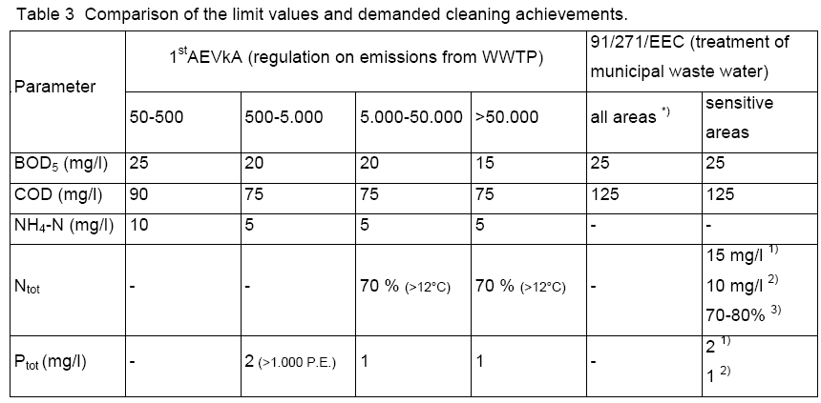
Introduction
Wastewater treatment in Austria - Legal requirements

Slide 16
Introduction
Wastewater treatment in Austria – Legal requirements
Austrian regulations for small plants (less than 500 persons; 1.AEVkA, 1996):
  maximum effluent concentration for NH₄-N: 10 mg/L (>12°C)
  organic matter effluent concentrations (90 mg COD/L and 25 mg BOD₅/L) and treatment efficiencies (85 % and 95 % for COD and BOD₅, respectively) have to be met the whole year
  no standard for total nitrogen and phosphorus
  no standard for microbial contamination
EU regulations
  no EU-wide regulation for WWTPs < 2000 p.e.

Slide 17
Introduction
Wastewater treatment in Austria - Basic data
Existing WWTPs with capacity > 50 PE in Austria (BMLFUW, 2014)
Number of small WWTPs (≤ 50 PE) unknown.
BMLFUW (2014): EU Richtlinie 91/271/EWG über die Behandlung von kommunalem Abwasser - Österreichischer Bericht 2014 (EU Directive 91/271/EWG on Urban Wastewater Treatment - Austrian Report 2014). Austrian Federal Ministry of Agriculture, Forestry, Environment and Water Management, Vienna, Austria [in German]

Slide 18
Number of small WWTPs
Design size
Total number and size distribution of small wastewater treatment plants (design size < 500 PE)
Langergraber, G., Weissenbacher, N. (2017): Survey on number and size distribution of TWs in Austria. Water Sci Technol 75(10), 2309-2315.

Slide 19
Number of small WWTPs
Technologies
Treatment technologies applied for wastewater treatment plants with design size < 50 PE

Slide 20
Number of small WWTPs
Technologies
Cumulative design size (in PE) of small WWTPs with design size < 50 PE

Slide 21
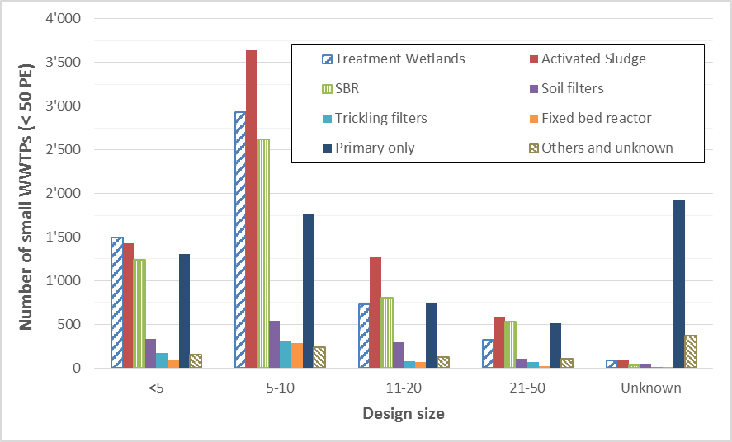
Number of small WWTPs
Design size

Slide 22
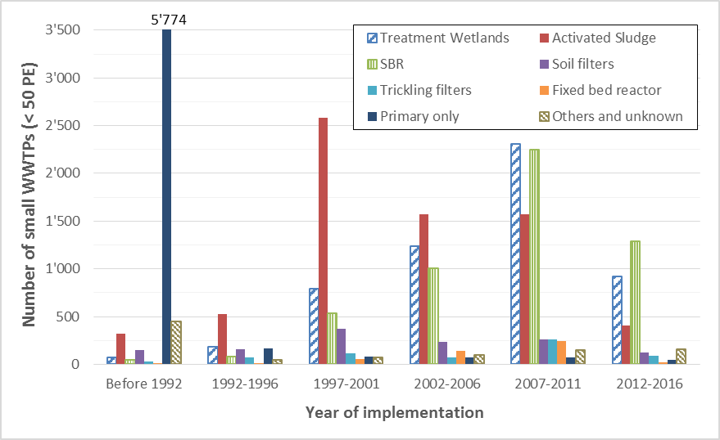
Number of small WWTPs
Year of commissioning

Slide 23
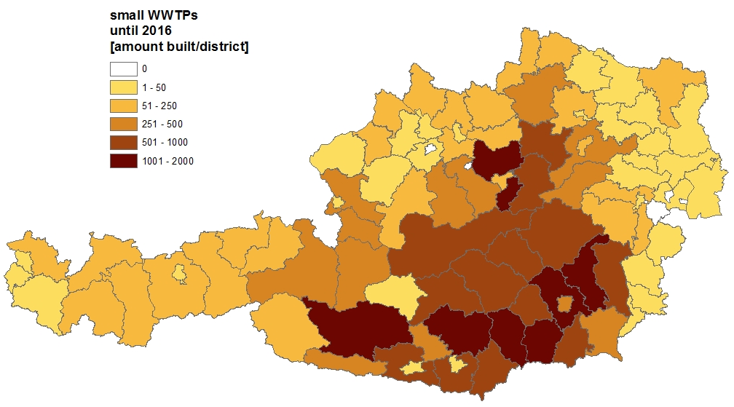
Number of small WWTPs and TWs
Number of small WWTPs (< 50 PE) in Austria per district

Slide 24

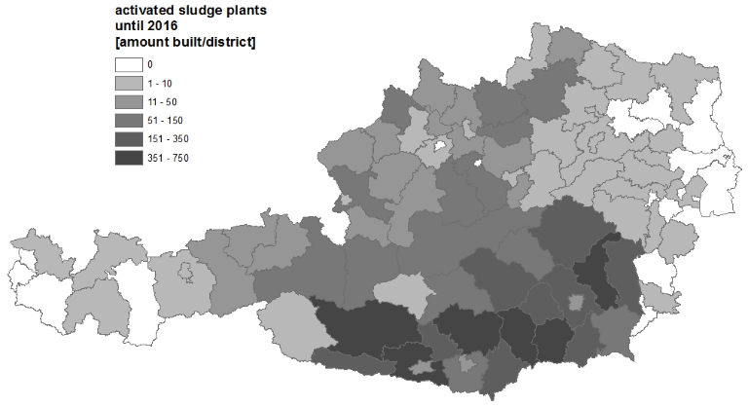
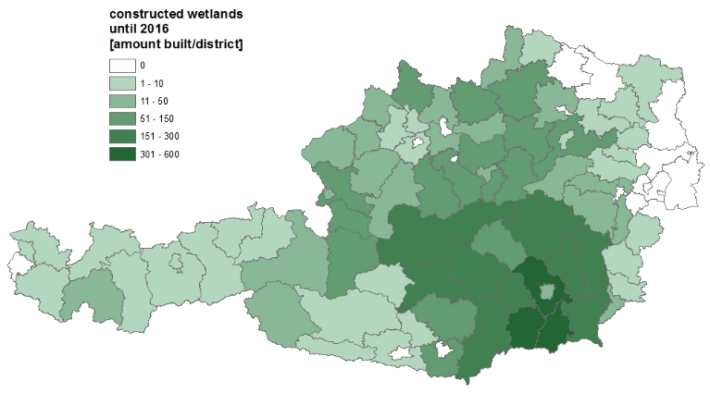
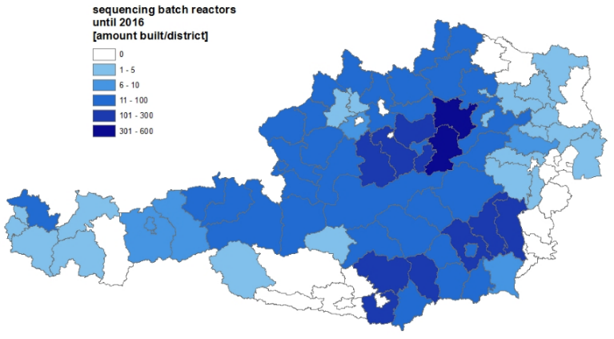
WWTPs ≤ 50 PE until 2016
All WWTPs ≤ 50 PE (27'087)
Activated sludge (6'608)
Treatment Wetlands (5'308)
SBR (4'200)

Slide 25
Management of small WWTPs 1
Permission to operate a small WWTP is given by local authorities on a case-by-case evaluation. The European certification procedure for small WWTPs as described in the standard EN 12556-3 (2005) is not applied in Austria as the plants are currently only tested for their ability to remove organic matter. Nitrification - that is mandatory in Austria - is generally not required for small WWTPs in most other European countries.
In most federal states, the permission for operating a small WWTP is granted for a period of 15 years. After this period, the permission can be extended if the WWTP is still according to the state-of-the-art, meaning it is able to treat the wastewater according to the legal requirements.
To get the permission several local authorities request that owners have a contract for operation and maintenance with a company or that owners of WWTPs take part in the training course for operators.

Slide 26
Management of small WWTPs 2
The permission to operate a small WWTP also includes the frequency in which self-monitoring of the plant has to be carried out by the owner of the WWTP.
Below 50 PE, self-monitoring usually includes weekly routine checks if the WWTP is working properly and monthly sampling and analysis of the following parameters: temperature and pH of effluent, effluent concentration of ammonia nitrogen and settable solids, and (if applicable) the sludge volume.
For WWTPs larger than 50 PE, sampling and analysis have to be done more frequently (bi-weekly or weekly). All results gained from self-monitoring as well as operational and maintenance work have to be documented in an operations dairy.

Slide 27
Management of small WWTPs 3
Besides self-monitoring, external monitoring is requested. Usually every two years external monitoring is requested for small WWTPs < 50 PE. In some federal states, the period of the external monitoring will be extended, e.g. to every three years, if owners of WWTPs successfully complete the training course for operators.
During external monitoring, effluent samples are also analysed for BOD5 and COD. Besides, the operations dairy including the data gained from self-monitoring are evaluated. Reports from external monitoring are sent to the local authorities for evaluation.

Slide 28
Training of operators in Austria
The Austrian Wastewater and Waste Association (Österreichischer Wasser- und Abfallwirtschaftsverband, ÖWAV) is responsible for the training of operators of wastewater treatment plants.
Special training courses
  for operators of small WWTPs (≤ 50 PE)
  for operators of WWTPs with 51 ≤ PE ≤ 500
  for operators of WWTPs with > 500 PE
  for sewer operators

Slide 29
Training of operators in Austria
WWTPs ≤ 50 PE (1)
A special training course for operators of small WWTPs (≤ 50 PE) has started in 2000. The Institute of Sanitary Engineering at BOKU University is responsible for the content of and running the trainings.
Between 2000 and 2018:
  > 200 training courses have been held (with about 4‘700 participants)
  ca. 45 special courses for owners of treatment wetlands (with about 1'000 participants) and
  ca. 15 training courses (with about 300 participants) for operators of WWTPs at Alpine refuges (in collaboration with the Austrian and German Alpine Associations)

Slide 30
Training of operators in Austria
WWTPs ≤ 50 PE (2)
The training lasts for 1.5 days and comprises
  1. theoretical knowledge on biological wastewater treatment, including main processes for organic matter and nutrient removal, and types of technologies applied.
  2. basics on operation and maintenance requirements,
  3. practical introduction into sampling and analysis (this part is carried out on a nearby WWTP which has a laboratory)
    analyses required for self-monitoring,
    methods available at larger WWTPs.
  4. field trips showcasing small WWTPs with different technologies.
  5. fundamentals of the legal requirements and subsistence system (this part is given by a person from the local authority with legal background)

Slide 31
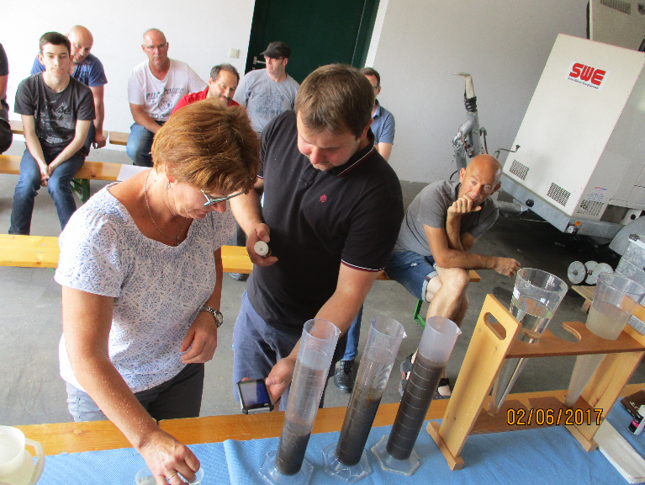
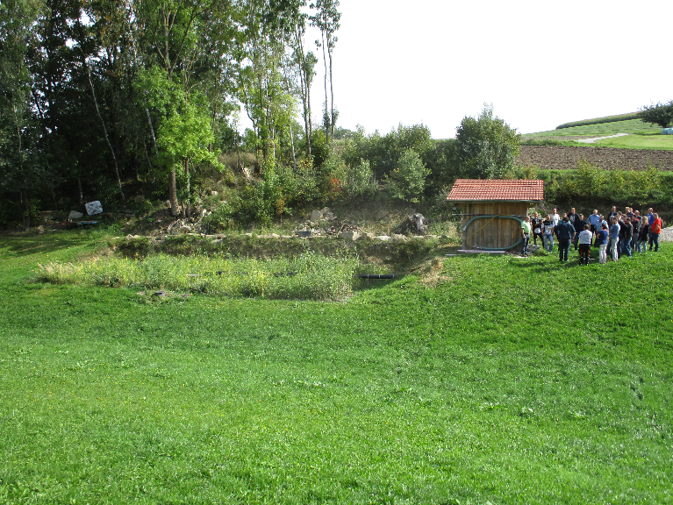
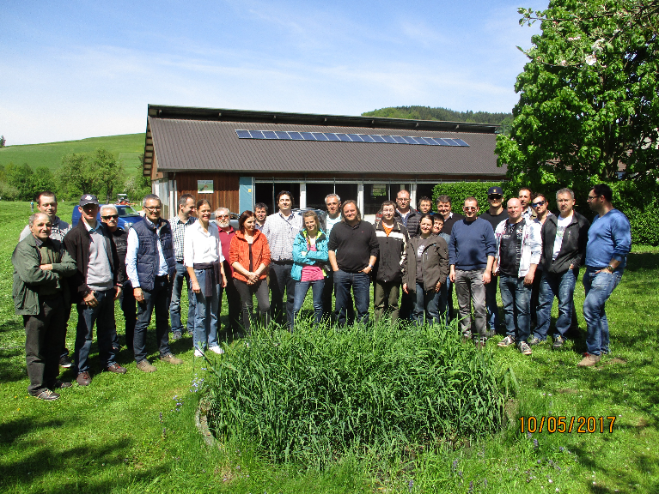
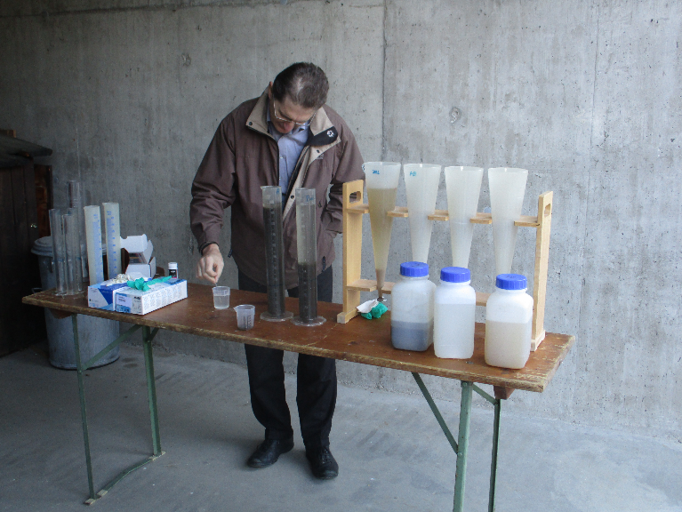

Slide 32
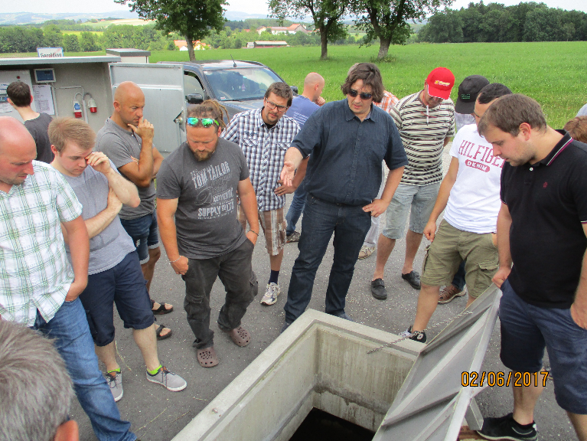
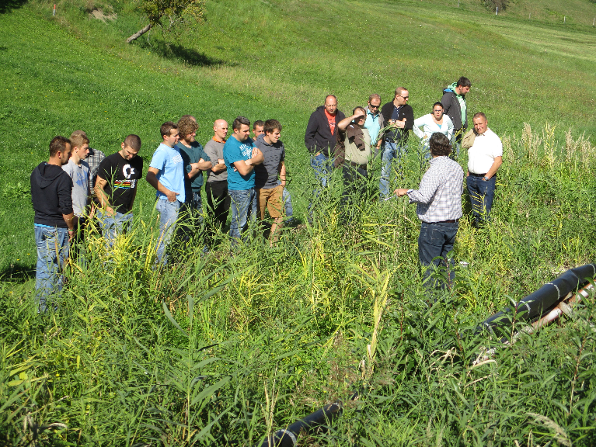
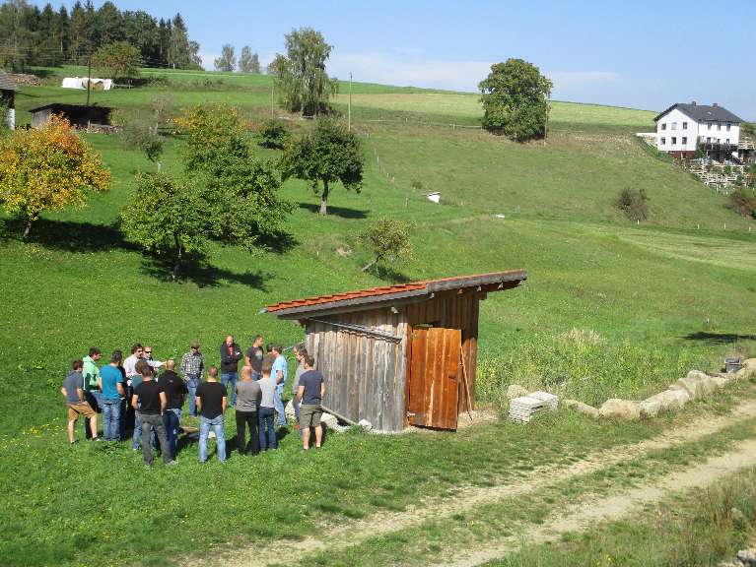
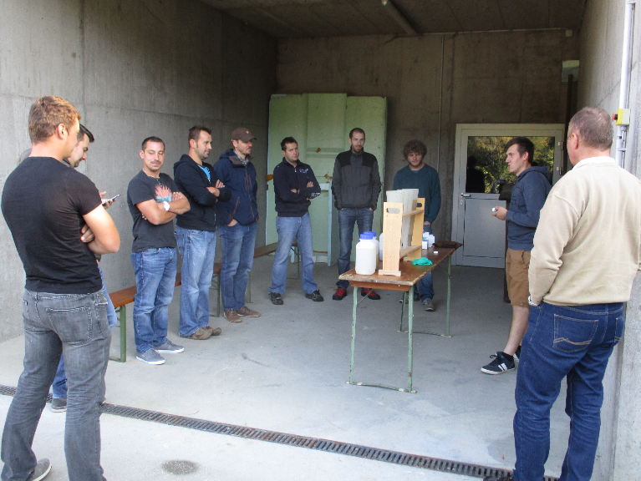

Slide 33
Training of operators in Austria
WWTPs 51 ≤ PE ≤ 500 (1)
For operators of WWTPs from 51 to 500 PE, a special course has been designed by ÖWAV.
  Duration: 14 days
In rural areas, WWTPs of this size are often organised as cooperative in which all members are responsible for the operation of the plant. Authorities often accept that the members of the cooperative can participate in the course for operators of small WWTPs with less than 50 PE even if the WWTP is larger than 50 PE.

Slide 34
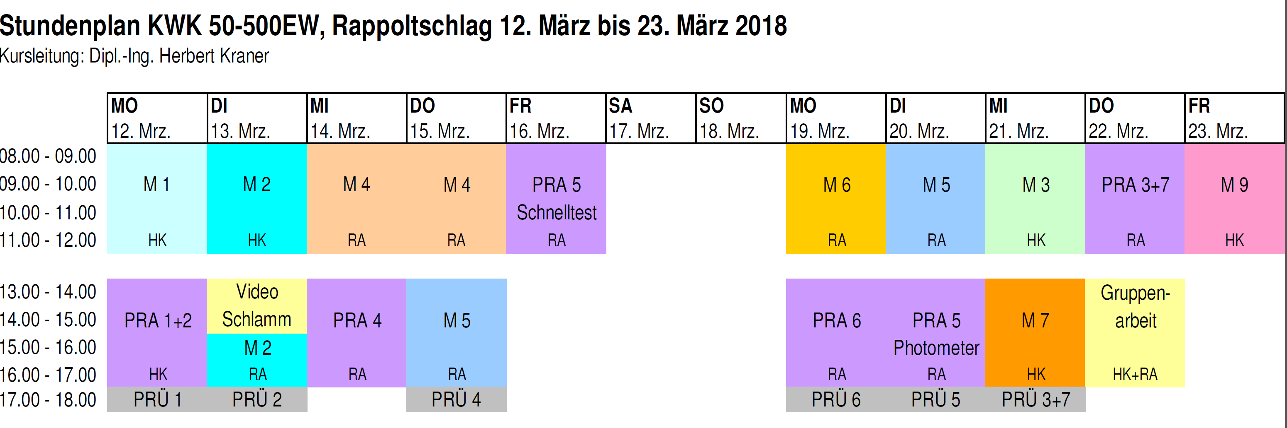
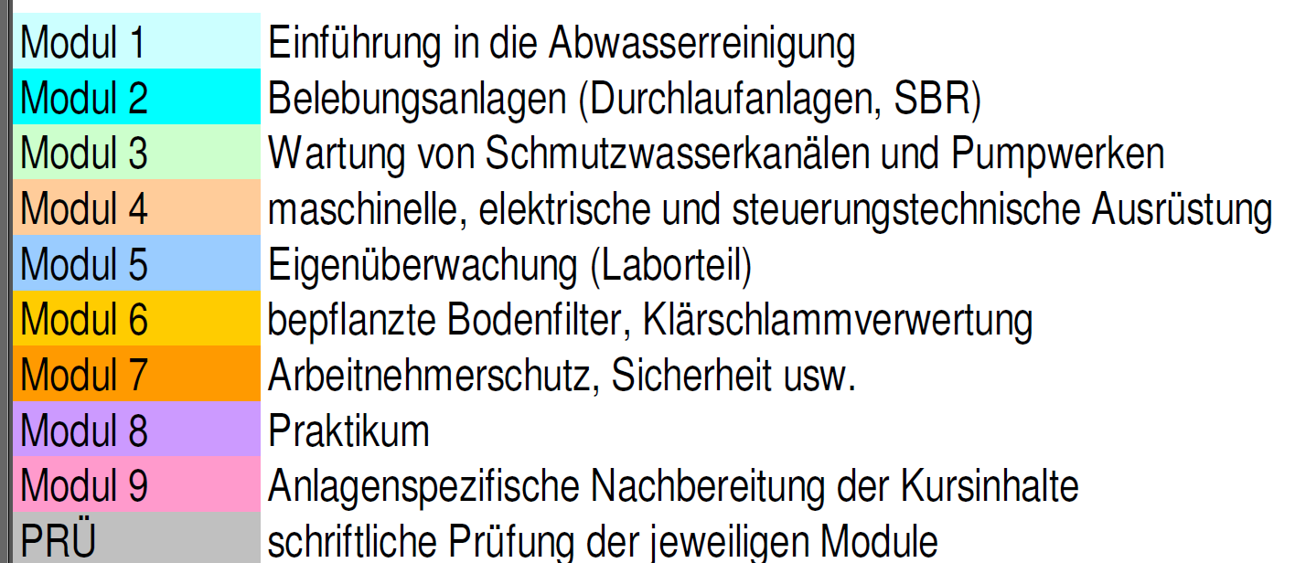
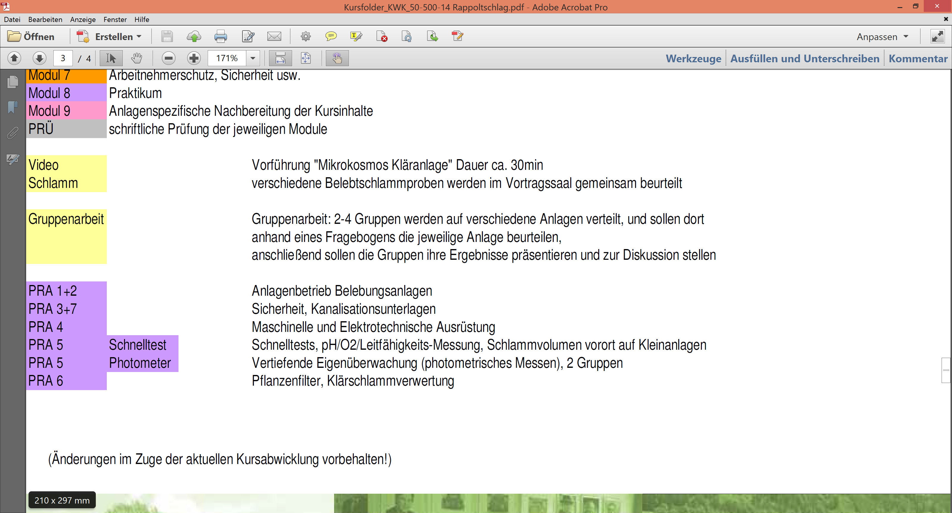

Slide 35
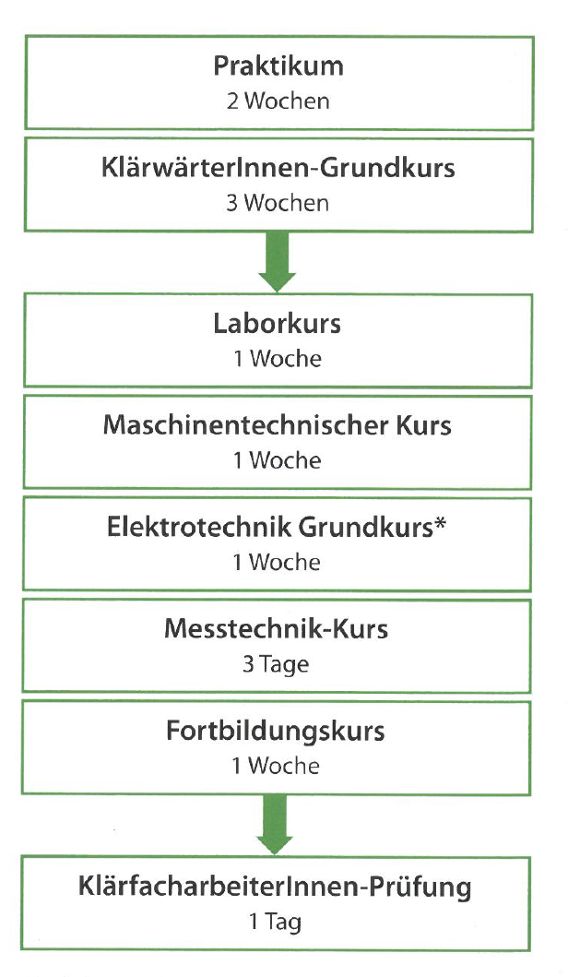
Training of operators in Austria
WWTPs > 500 PE
Training over 3 years in parallel to working at your utility (2 year if special qualification, e.g. professional electrician, metal worker, etc.)
Basic knowledge
  Training on the job (2 weeks)
  Fundamentals (3 weeks)
Specialisation
  Laboratory (1 week)
  Mechanical engineering (1 week)
  Electrical engineering (1 week)
  Measurement technology (3 days)
  Advanced training (1 week)
Exam (1 day)

Slide 36
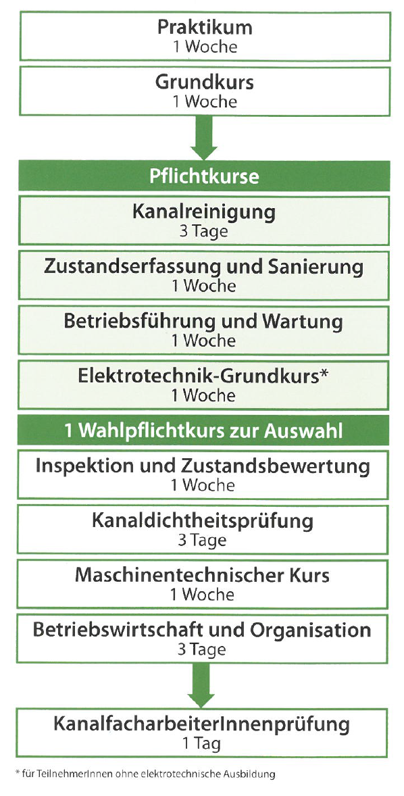
Training of operators in Austria
Sewer operators
Training over 3 years in parallel to working at your utility (2 year if special qualification)
Basic knowledge
  Training on the job (1 week)
  Fundamentals (1 week)
Mandatory courses
  Sewer cleaning (3 days)
  Survey and rehabilitation (1 week)
  Operation and maintenance (1 week)
  Electrical engineering (1 week)
Additionally one elective course
  Sewer inspection, evaluation of damages (1 week)
  Leak testing (3 days)
  Mechanical engineering (1 week)
  Business administration, organisation (3 days)
Exam (1 day)

Slide 37

Contact
Dr. Guenter Langergraber
Head of the Department
University of Natural Resources and Life Sciences, Vienna (BOKU University)
Department of Water, Atmosphere and Environment
Institute of Sanitary Engineering and Water Pollution Control
Muthgasse 18, A-1190 Vienna, Austria
Tel.: +43 (0)1 47654-81111
Email: guenter.langergraber@boku.ac.at

